Slide 1

Image

Slide 2
Project Associates:
Guide:
Mrs. Ranjini S.
Team: Roll No
Harish Patil 12
Pavankumar B. L. 23
Pradeep C. 26
Priyanka Patil 29

Slide 3
Contents:
Problem Definition
System Model
Functional Requirements
Non-Functional Requirements
Game Play
Motion Sensing Puzzle
Database Connectivity
Background Audio

Slide 4
Problem Definition
To develop a game application which will push the user’s intelligent level to its best. Different levels of puzzles are taken with interesting constraints imposed on the user. And will challenge the user to answer the questions to reach the final goal.

Slide 5
SYSTEM MODEL

Slide 6
Windows phone 7
Launch Game
Audio Library
Main Menu
Game Introduction
Exchange of information from the Database
Database Access
Different Levels
Game Over

Slide 7
FUNCTIONAL REQUIREMENTS:
Motion of the Images
Playing background audio
Retrieving the relevant data
Using accelerometer features in one of the puzzles

Slide 8
NON-FUNCTIONAL REQUIREMENTS:
Our app requires maximum of 10Mb memory.
Reliability- This app runs 99% of the times.
Response time- This app’s response time is 0.5s.
Speed- Depends on the mobile’s main memory.
Portability- Meets out all the requirements of the customer.
Performance- The performance is better if the user downloads the app properly.

Slide 9
Game Play
Creating GUI
Motion of the Images
Placing the images at the right place.

Slide 10
Motion sensing Puzzle
The orientation of the device during the game.
Making use of phone’s accelerometer features to create puzzle

Slide 11
Accessing the Database and Editing the Images
Requests the background file transfer.
Enabling the management of the background file transfer
click

Slide 12
Motion of the images is portrayed well.
Communication between Xaml pages is completed.
Image editing of initial level is completed
The arena for the accelerometer is yet to be changed, but the game is done.
click

Slide 13
THANK YOU…

Slide 14


Slide 15
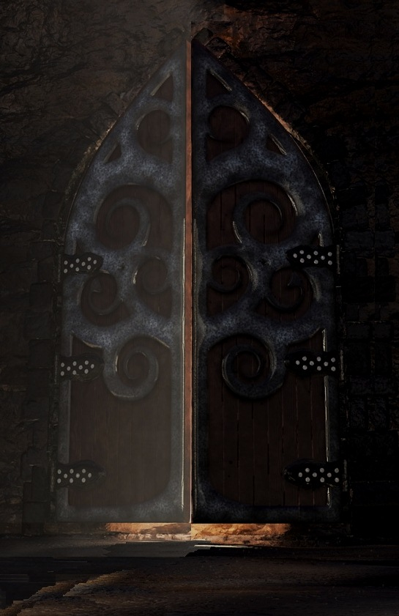
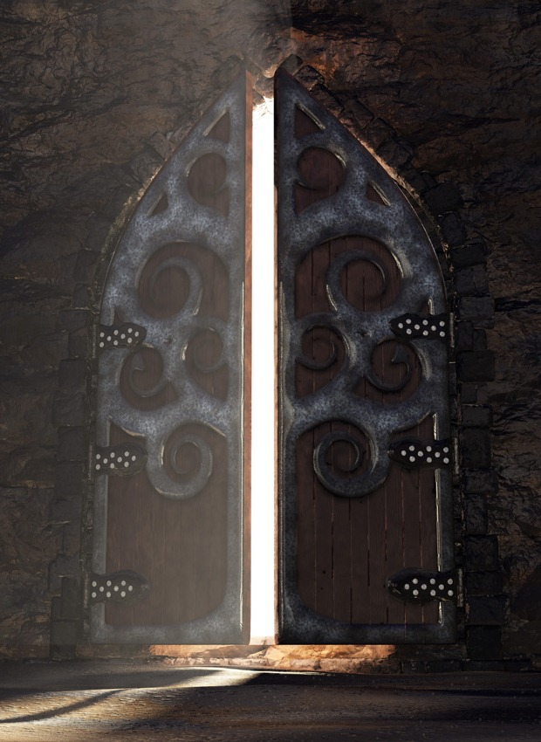

Slide 16
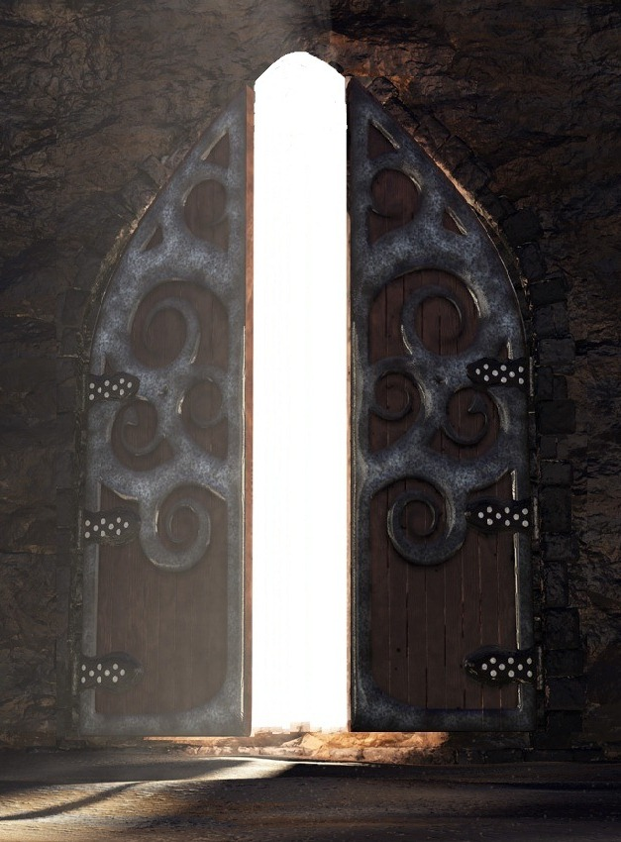

back

Slide 17
